Slide 1

Ruby on Rails

Slide 2
About today…
Ruby on Rails
Intro to ERB
Use of ERB
Creating Views

Slide 3


Slide 4

Introduction to ERB in Ruby on Rails
ERB allows embedding Ruby code within HTML
Generates dynamic content based on data from controllers/models

Slide 5

Setting Up Views in Rails
File Structure
Views located in app/views directory
Naming convention
controller_name/action.html.erb

Slide 6
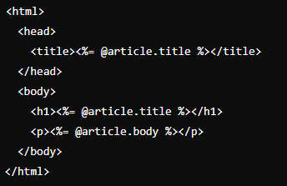
Basic Structure of an ERB Template
File Extension
.html.erb
Syntax
<%= %>
Evaluates Ruby code and inserts the result into HTML

Slide 7
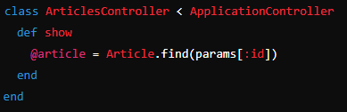

Accessing Instance Variables
Passing Data from Controller
Instance variables set in controller actions

Slide 8
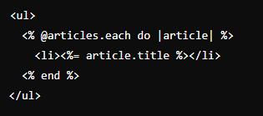
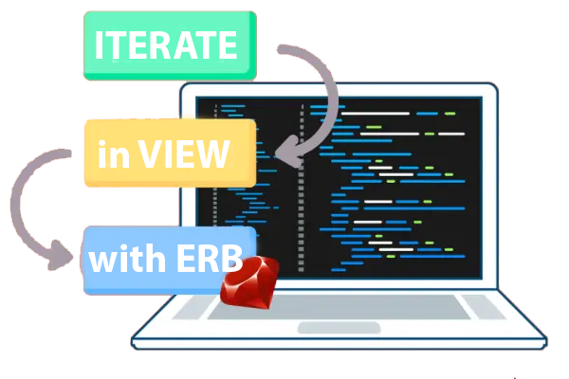
Iterating with Ruby in Views
Displaying Collections
Using Ruby each loop to iterate over collections

Slide 9

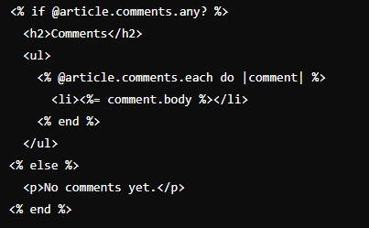
Conditional Statements in Views
Conditional Rendering
Using if, else, and unless statements in ERB

Slide 10


Slide 11

What is the purpose of ERB (Embedded Ruby) in Ruby on Rails?
Where are Rails views typically located?
Which file extension is used for views that contain ERB code?
How do you access instance variables set in a Rails controller within an ERB view?
How would you iterate over a collection of articles in a Rails view using ERB?

Slide 12

Task 1
Create a basic Rails view file and embed Ruby code to display dynamic content
Task 2
Practice iterating over a collection of articles and displaying them in a list format

